Slide 1


Strategic Scrum
Jason Knight
Sr. Scrum Master
MortgageNow
How to NOT screw up Metrics in Scrum
Notes:
Good afternoon. My name is Jason Knight and I’m the Sr. Scrum Master in the Mortgage department. Over the past few months, I’ve been grappling with recommending a way for agile teams to use metrics in their work. Most metrics I’ve encountered can be misused and create pain, so I figured I’d talk about a way to link big goals, strategy, metrics and execution in a way that minimizes that possibility. Buckle up, we’re gonna talk about how NOT to screw up metrics in Scrum.

Slide 2

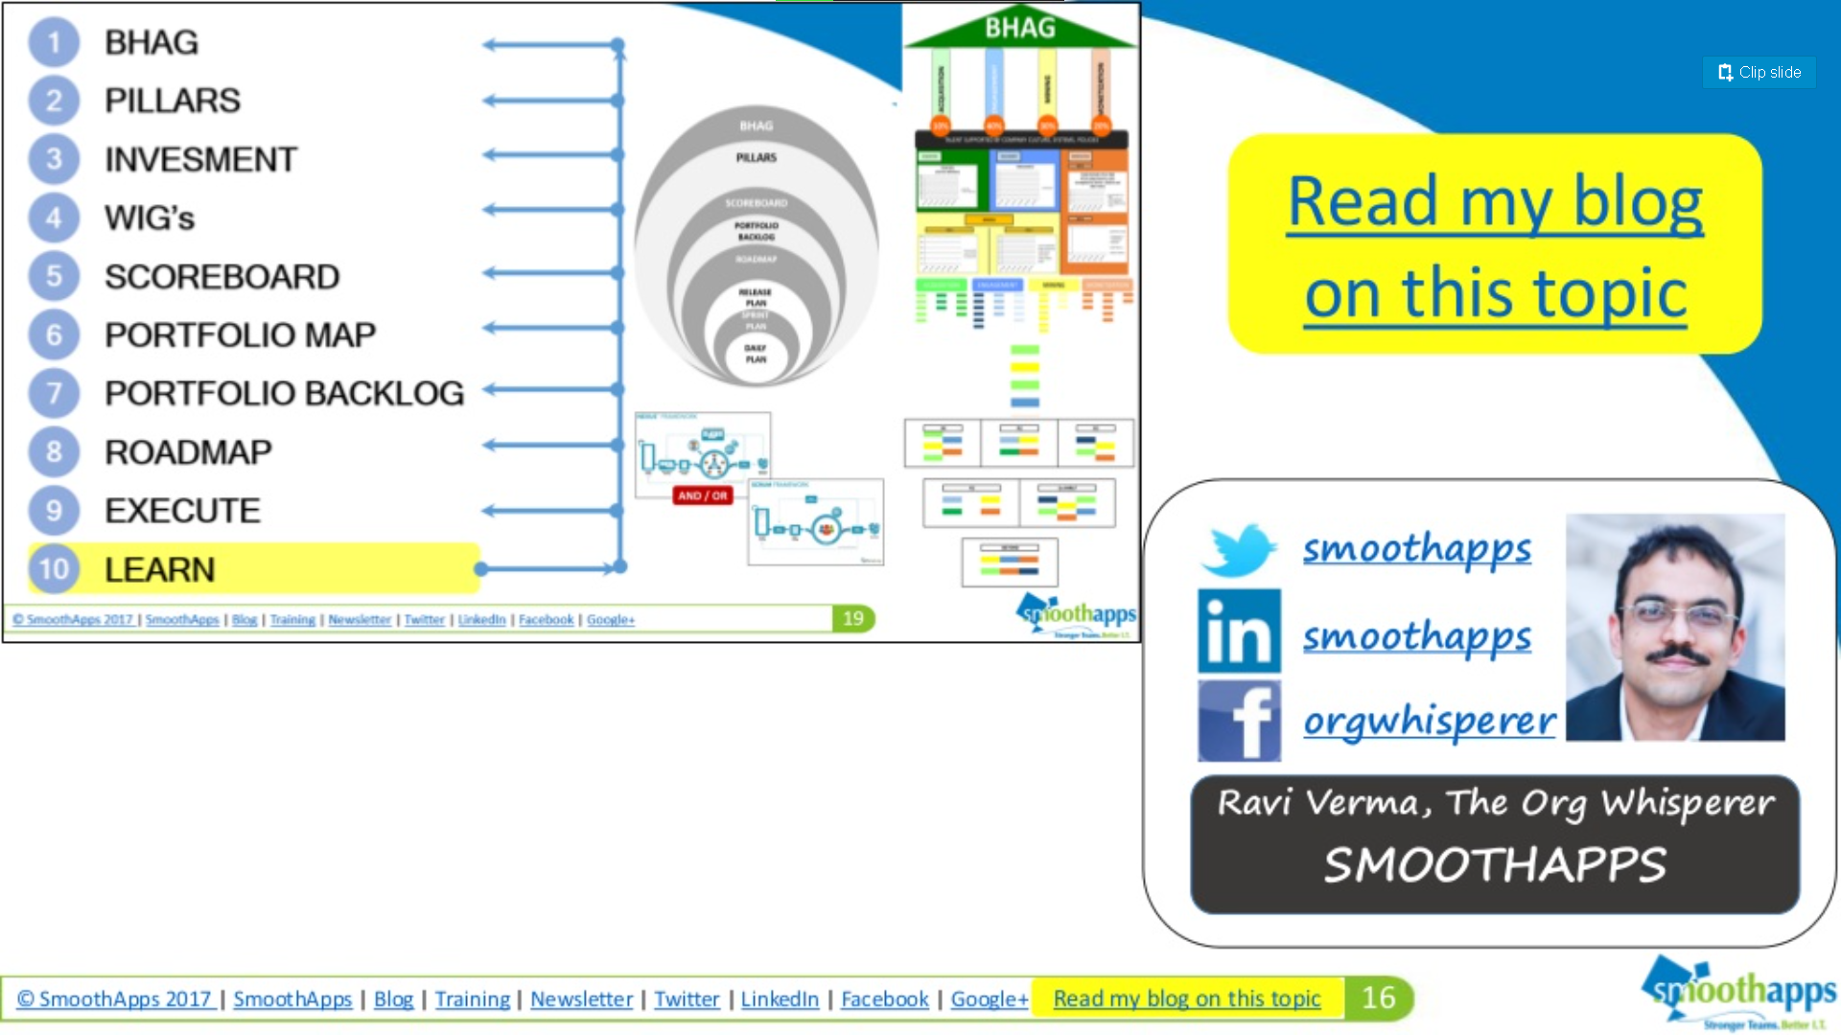
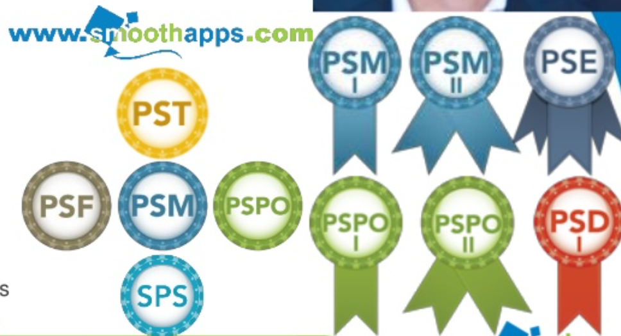


Ravi Verma
Notes:
First, I’d be remiss if I didn’t acknowledge the author of most of the content in this talk, Ravi Verma. Ravis has spent decades honing his craft, consulting with companies big and small, and growing to be an important part of Scrum.org’s Professional Scrum trainer community. I chose his talk to respectively pilfer because he has way more enterprise coaching experience than I do. He developed most of the content in this talk. I have added in a few slides to go deeper on metrics, but the structure of “Strategic Scrum” is his. Credit where credit is due.
As a side note, Ravi has worked as an enterprise coach for a Federal bank. If you are listening to this talk and ever wish you could get coaching help here at BOKF, I can recommend Ravi highly for you to consider.
Ok, on with the show.

Slide 3

Fist to Five
Go to www.menti.com and use the code 1669 4783
Notes:
I’d like to start with a poll. Please go to menti.com and enter in code 1669 4783. I’ll go there now.

Slide 4

So What. Why Bother!?
Scrum Teams | Executives
Why are we doing this? | Why did they just do that?
Are we adding value? | Why don’t they just get it?
Can I get some help with these impediments? | Scrum teams are supposed to be self-organizing. Shouldn’t they be able handle this themselves?
I know we have problems but don’t know what to do about them
Notes:
So why is this kind of understanding between CXO’s and Scrum teams important? When alignment and understanding is low, you may hear these kinds of questions.
Executives may become confused, disappointed, or upset with Scrum teams and Scrum teams may feel the same way about their executive leadership. One thing seems likely to me. They both may recognize that they have big problems and don’t know what to do about them.

Slide 5
When Good Metrics Go Bad
Number of bugs found
Story Point Velocity
Commitment Forecast completion percentage
Percentage of teams using Scrum OR agile team maturity metrics
Notes:
When big problems exist, one approach is to tackling them is to choose important measurements that track progress towards fixing them. I’ve learned over the years is that even well-intentioned metrics can go bad. They can even produce what you don’t want rather than the things you do.
[animation]
I read a story about a company that wanted to improve the quality of its software, so it started measure # of bugs found. They paid a small reward, we’ll say $2 for every bug the QA department found. As a result, an unexpected but predictable things happened. Developers and QA folks conspired to game the system. Developers would introduce bugs and QA would “find” them. They split the rewards amongst themselves. There’s a saying, “Game theory works. Make sure you create the right game.”
[animation]
Story point velocity can go south as well. Instead of a Scrum team using it as a helpful forecasting metric, organization might start using it to measure productivity. They may even try to normalize story points across multiple teams so that points fit well inside a large Gantt chart. They could also decide to charge their customers $2,500 per story point delivered. You may laugh at this, but this is what happened at my previous company. The bright side is, if they ever want to increase their revenue, the Scrum teams could just start pointing their stories a bit higher ☺.
[animation]
Measuring the percentage of planned product backlog items made “Done” in a Sprint can be a useful metric for Scrum teams; it can help them see that they are over or underestimating their ability to make work “Done.” From there, they can investigate and find ways to adapt their practices to better delight their Product Owner. When it goes bad, it can also be used to call Scrum teams to work overtime to “keep their commitments” or to blame teams for slacking off when they consistently accomplish less than they forecast. Think of how bad that would be. You and your Scrum team decide to courageously tackle a really hard problem. You learn a lot, accomplish a great deal, but fall short. As a result, you are told you are slacking off. Not good at all. The next time a hard problem presents itself, you’ll have a powerful motivation to leave it for someone else and stick to the safe path through the backlog.
Notice also how I struck through “Commitment” and replaced it with “Forecast.” Many years ago, the Scrum Guide was updated such that Scrum teams produced a forecast in Sprint Planning rather than a commitment. This was done precisely because Scrum teams were getting beat up for “not fulfilling their commitments.” The reality is a Scrum team is not asked to commit to getting a set number or work items “Done” but rather to be committed to achieving its goals and to supporting each other.
[animation]
I know I’ve been harping on management for getting metrics wrong and causing problems for Scrum teams, but the opposite can be true too. Agile transformation metrics or team maturity metrics can be deceiving. Imagine you are an executive who has gone out on a limb to support a grass-roots effort to increase business agility using Scrum. You are told that 100% of the targeted teams are now using Scrum! They have the maturity metrics to prove it. They no longer have project managers, they have Scrum Masters. They no longer make year-long plans, they have a product backlog. They even have team agreements, Definitions of “Done” and short Sprints. You may wake up one day and realize that the teams have actually change “project manager” roles to “Scrum Master” roles but haven’t changed what those people do. They may also have a definition of “Done” that they rarely enforce. They may have a product baklog, but it’s create months in advance of the work, and doesn’t change much throughout the product’s development lifecycle. You realize they may tick the “using Scrum” box, but in reality have stopped far short. This has stunted improvements, caused significant disruption, and worst of all you now wonder if this Scrum thing or even agility in general could ever work here.

Slide 6
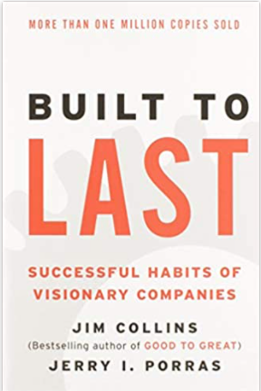
BHAG
BHAG
“…a true BHAG is clear and compelling and serves as a unifying focal point of effort– often creating immense team spirit. It has a clear finish line, so the organization can know when it has achieved the goal; people like to shoot for finish lines.” – Collins and Porras
To eradicate the kerosene lamp from Africa by 2020 – Solaraid
To cure blood cancer through marrow donation by ensuring a match for every patient in need, whenever they need one – Gift of Life Marrow Registry
To make the world more open and connected – Facebook
To be Earth’s most customer-centric company – Amazon
Enable human exploration and settlement of Mars - SpaceX
Notes:
So how can you keep good metrics from going wild? Some structure can really help. Let’s start at the top and build it out together, with some help from Jim Collins and Jerry Porras.
[animation]
BHAG stands for Big Hairy Audacious Goal. A BHAG is a great North Star that focuses an organization’s efforts. It is clear and compelling and can inspire a great deal of team spirit. Take a look at some of those BHAGs towards the bottom. They are so big and so audacious that they cannot be achieved with half-measures. They are like roofs that must be supported by a firm structure. Enter, strategic pillars.

Slide 7

BHAG
Pillars
Learn
Execute
Roadmap
Portfolio Backlog
Portfolio Map
Scoreboard
WIGs / OKRs
Investment
BHAG
“Pillars provide strength and support for something. In the case of strategy formulation, strategic pillars hold up the vision.
Remove a pillar, and the vision is in risk of collapse.” – Greg Githens
What are the Strategic Pillars that Support the Vision?
Notes:
Greg Githens, an authority on the use of strategy in organizations, says that “In strategy formulation, strategic pillars hold up the vision. Remove a pillar, and the vision is in risk of collapse.” That makes intuitive sense when considering a physical structure, but is less clear in the case of an organization’s strategy. Let’s look at the example of Facebook.

Slide 8
BHAG
Pillars
Learn
Execute
Roadmap
Portfolio Backlog
Portfolio Map
Scoreboard
WIGs / OKRs
Investment
BHAG
Acquisition
Engagement
Mining
Monetization
TALENT SUPPORTED BY COMPANY CULTURE, SYSTEMS, POLICIES
Facebook’s strategic pillars could be…
ACQUIRE: get more people to join Facebook
ENGAGE: get users to post content, like, share, comment
MINE: mine user content and behavior to extract insights on trends and patterns
MONETIZE: sell insights to advertisers
Complement pillars with a business model using a canvas like Roman Pichler’s Extended Product Vision Canvas
Notes:
Recall, Facebook’s BHAG is, “To make the world more open and connected.” These are some strategic pillars they might have chosen.
[animation]
Acquisition – getting more people to join Facebook
[animation]
Engagement – getting users to post content, like, share, comment, etc
[animation]
Mining – mining user content and behavior to extract insights on trends and patterns
[animation]
Monetization: selling insights to advertisers
Each one of these pillars represents an area of focus that supports the BHAG. Most importantly, all are aligned by the BHAG. If a particular engagement strategy does not make the work more open and connected, it should be discarded.
[animation]
Other complementary tools like Roman Pichler’s Extended Product Vision Canvas may be used to explore target groups, needs, competitors, etc.
Hmm, now what am I forgetting. Oh yeah!
[animation]
We need a foundation It is what provide stability and definition for attempting something like a BHAG. Without the people, culture, systems and policies needed, the best strategy would be of no help achieving the BHAG.

Slide 9
BHAG
Pillars
Learn
Execute
Roadmap
Portfolio Backlog
Portfolio Map
Scoreboard
WIGs / OKRs
Investment
BHAG
Acquisition
Engagement
Mining
Monetization
10%
40
30%
20%
TALENT SUPPORTED BY COMPANY CULTURE, SYSTEMS, POLICIES
Unique investment for each pillar
Guidelines, not handcuffs
This approach can apply recursively
Company – Microsoft
Suite – Office
Product – PowerPoint
Agile Portfolio Management – Jochen Krebs
Notes:
There’s never enough time, money, or people to do all that needs doing. Given that, we need to build in some investment scheme into the work called for in these pillars. One way would be to assign percentages to each which indicate how much effort we spend making progress towards each.
[animation]
These allocations represent a unique investment for each pillar. I allows executives and Product Owners to look into the future and take bets about which strategic area holds the most promise in a given period of time.
[animation]
It’s important that these investments be treated as guidelines and not handcuffs. This needs to be a strategic framework, not a plan that must be followed at all costs.
[animation]
This approach works recursively. For example, Microsoft may have strategic pillars for their company BHAG. The Office teams may focus primarily on just a couple and develop their own strategic pillars that support just one or two. Finally, the PowerPoint team may do the same. Though we’re now at the level if a single Scrum team, they have a clear strategy that applies directly to their product’s backlog.
[animation]
If you’re interested in diving deeper in Agile Portfolio Management, Ravi recommends reading Jochen Krebs’ book of the same name.

Slide 10
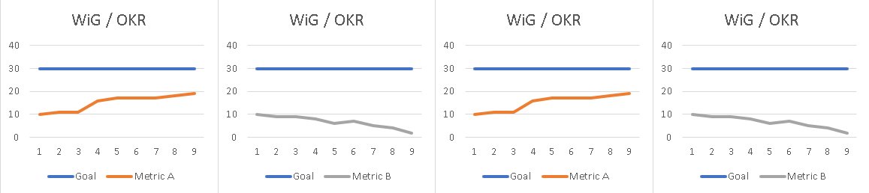
BHAG
Pillars
Learn
Execute
Roadmap
Portfolio Backlog
Portfolio Map
Scoreboard
WIGs / OKRs
Investment
BHAG
Acquisition
Engagement
Mining
Monetization
Example OKR O: Increase profit from 5% to 10% by end of Q4 KR1: Implement a supplier registration reverse auction system and save 10% on purchases
KR2: Outsource the distribution fleet to stores and reduce costs by 25%
KR3: Launch seasonal campaigns on Valentine’s Day, mothers and fathers days and double the revenue from the past year.
10%
40%
30%
20%
TALENT SUPPORTED BY COMPANY CULTURE, SYSTEMS, POLICIES
Define WiGs or OKRs for each pillar
4 Disciplines of Execution – Covey; “Measure What Matters” – Doerr
“Increase/decrease ? from ? to ? by ?”
Complement with Scrum.org Evidence Based Management
Notes:
Now that we’ve reached Scrum teams and their Product Backlogs, we need a way for them create their Sprint Goals and measure progress towards accomplishing the BHAG through the strategic pillars. One way to do this is to use techniques like Wildly Important Goals or Objectives with Key Results.
[animation]
In short, each are structured goal creation techniques that rely on collaborative work, frequent inspection of measurable outcomes, and alignment with larger goals
[animation]
WiGs and OKR both use a similar structure, here’s an example: “Increase/decrease something from some point to another point by some date in the future. OKR’s take it a bit further by including Key Results that measure either quantifiable metrics that indicate progress or qualitative milestones that do the same. Here’s an example OKR
[animation]
Notice the quantifiable metrics that may be tracked on a chart like the ones you see under our BHAG building. This is a crucial link between the BHAG and a Scrum team’s work.
[animation]
There are many sources of helpful metrics you might use in WiGs and OKRs. One of which we’ll look at next, Scrum.org’s Evidence Based Management for Software Development guide.

Slide 11
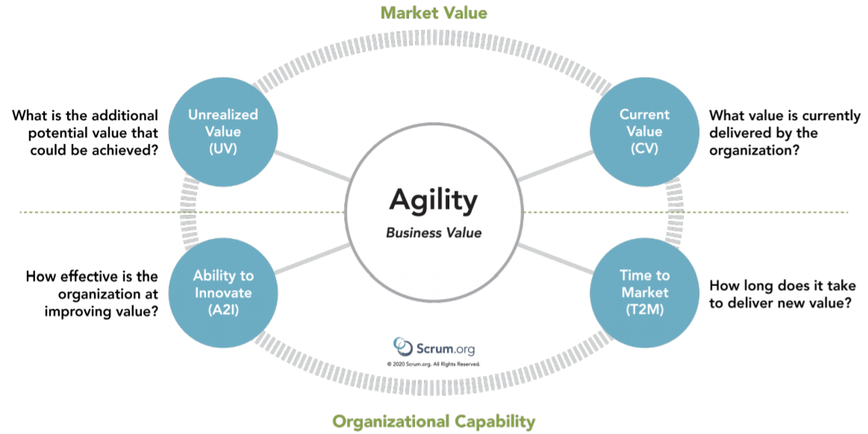
Notes:
The EBM guide recommends 4 Key Value Areas that can be measured to help an organization inspect and adapt in order to improve how it optimizes the value it produces, how it manages its risk, and avoids waste. They are:
Unrealized Value
Current Value
Ability to Innovate
Time to Market
Alright, it’s finally time to meet some of those metrics we talked about earlier. Armed with our BHAG, strategic pillars, investment and goals, let’s dive in!

Slide 12
Current Value | Unrealized Value | Time to Market (T2M) | Ability to Innovate
Revenue per Employee | Market Share | Build and Integration Frequency | Innovation Rate
Product Cost Ratio | Customer or User Satisfaction Gap | Release Frequency | Defect Trends
Employee Satisfaction | Desired Customer Experience or satisfaction | Release Stabilization Period | On-Product Index
Customer Satisfaction |  | Mean Time to Repair | Installed Version Index
Customer Usage Index |  | Customer Cycle Time | Technical Debt
 |  | Lead Time | Product Incident Count
 |  | Lead Time for Changes | Active Product (Code) Branches
 |  | Deployment Frequency | Time Spent Merging Code Between Branches
 |  | Time to Restore Service | Time Spent Context-Switching
 |  | Time-to-Learn | Change Failure Rate
 |  | Time to Remove Impediment
 |  | Time to Pivot
Notes:
These are just a few of the metrics we might use. Notice, each are organized within a Key Value area. This is important because it helps you measure the things most important to your goals, strategy investment, and ultimately your BHAG.
Let’s pause here for a moment and get some interactivity going. I’ll you all a question, and we’ll have a conversation about these things. Feel free to ask about what some of these mean.
Which of these metrics do you see as most important to measure in your teams?

Slide 13
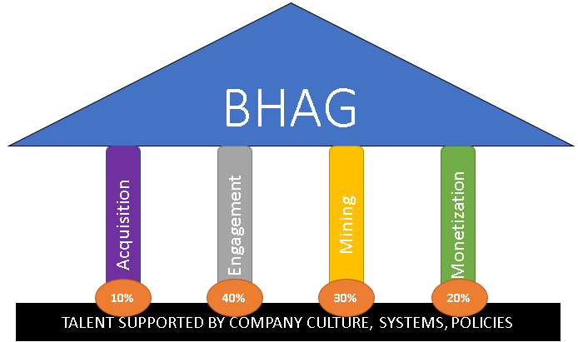
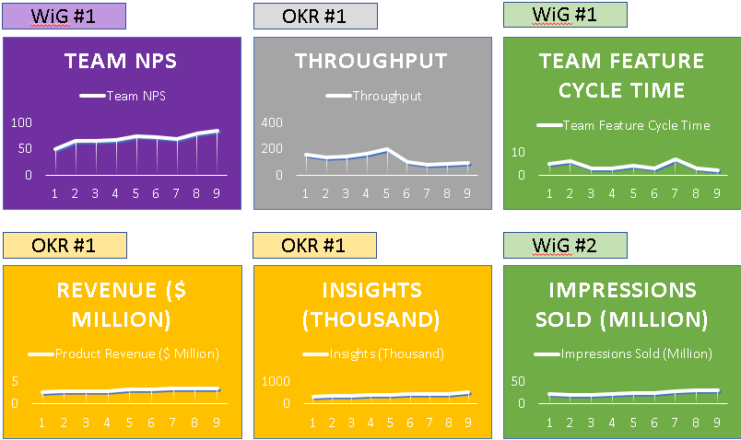
BHAG
Pillars
Learn
Execute
Roadmap
Portfolio Backlog
Portfolio Map
Scoreboard
WIGs / OKRs
Investment
Notes:
Ok, now that we have created our WiGs and OKR’s and important metrics, we need to keep our focus on how the results of our work are affecting them. One way we could do this is by having a scoreboard displaying our progress Sprint over Sprint. Notice we organize each visualization of progress by the strategic pillar and goal it is serving. Doing this keeps us remembering our strategic framework and increases the chance that we say “no” to work that distracts us. We also avoid being inattentive to the results of our work.
This scoreboard should be posted somewhere everyone can get to them. For inspection and adaptation to work, people responsible for the outcomes must have ready access to the impact of their efforts. The scoreboard must be checked frequently. A good time would be during a Sprint Review. There, Scrum teams and their stakeholders can excitedly check to see if they are progressing towards achieving their goals. It’s like a sports team and their fans eagerly watching their score increase or a shot clock run down.

Slide 14
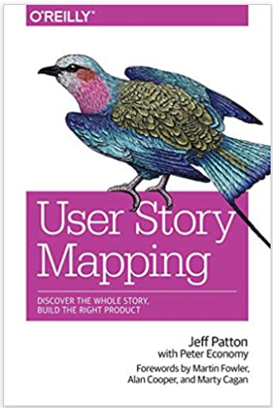
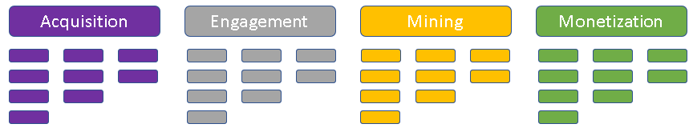
BHAG
Pillars
Learn
Execute
Roadmap
Portfolio Backlog
Portfolio Map
Scoreboard
WIGs / OKRs
Investment
Notes:
I said before we had reached the level of a Scrum team’s Product Backlog, but we need to go deeper still and create a Portfolio Map with actual backlog items. We can use a technique like Jeff Patton’s User Story Mapping to create something like what you see here. It’s a 3-dimensional organization of the backlog that tells the story of the portfolio of our work, perhaps across multiple Scrum teams. A key reason to create a portfolio map is to organize our backlog work into the strategic pillars that support the BHAG. This enables us to take the next, logical step: bringing this into our Scrum teams’ Product backlog.

Slide 15

BHAG
Pillars
Learn
Execute
Roadmap
Portfolio Backlog
Portfolio Map
Scoreboard
WIGs / OKRs
Investment
Notes:
Now we’re really home: a flat list product backlog! This is the structure most of us use on a daily basis, only this time we have a clear indication of how the backlog items we work each day relate to clear goals, measurable results, strategic thinking, and ultimately accomplish a Big Hairy Audacious Goal! It makes clear how the order established by our Product Owners is serving to optimize the value assumed by the strategic framework.

Slide 16

Thoughts? Questions?

Slide 17
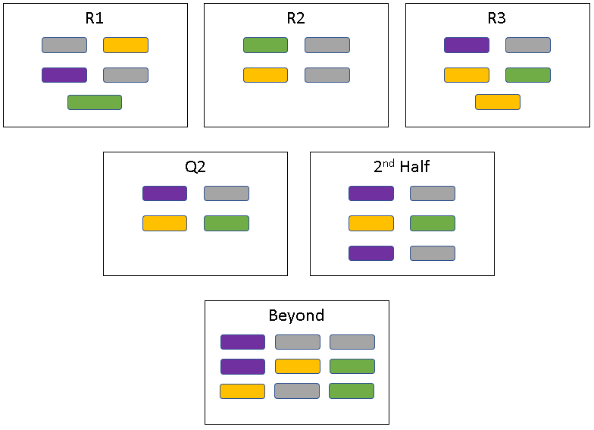
BHAG
Pillars
Learn
Execute
Roadmap
Portfolio Backlog
Portfolio Map
Scoreboard
WIGs / OKRs
Investment
Notes:
It’s often helpful to have a Release Roadmap. This can be done fairly simply by slicing up an ordered backlog into chunks that accomplish significant impact in the market. Having these distinctions can help to coordinate things like marketing, training, and product communication by telling the story of a long’ish span of time. I should say that these Roadmaps should also be treated as guidelines and not handcuffs; if Scrum teams discover new realities in the market place, the organization should leap at the opportunity to harness that opportunity to gain competitive advantage. So now we have this colorful framework for understanding our work, what do we actually do to accomplish it?!

Slide 18
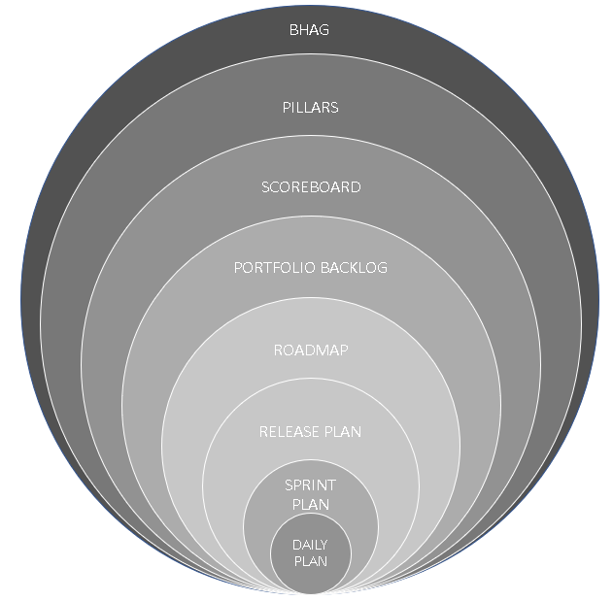
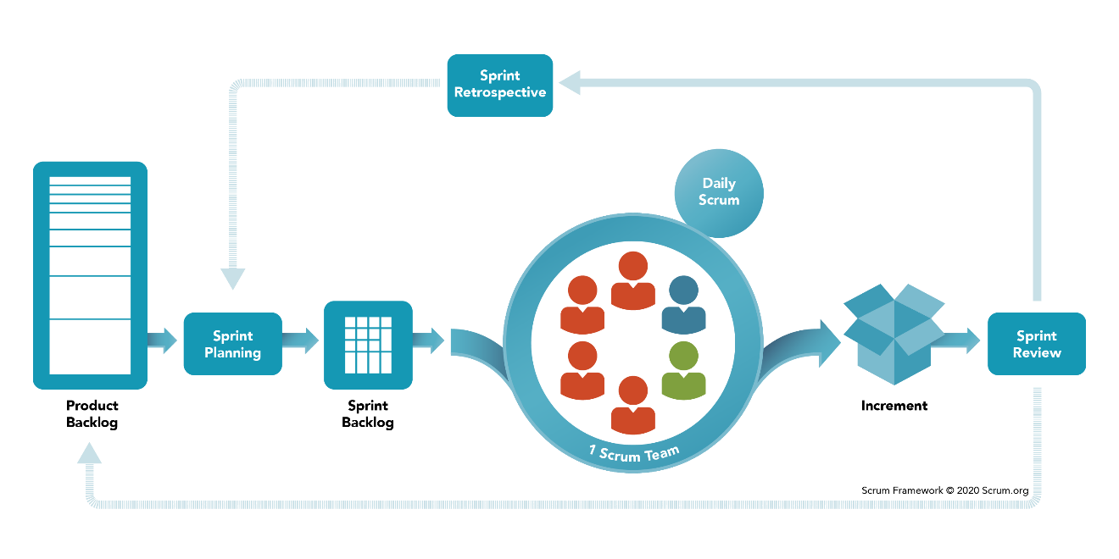
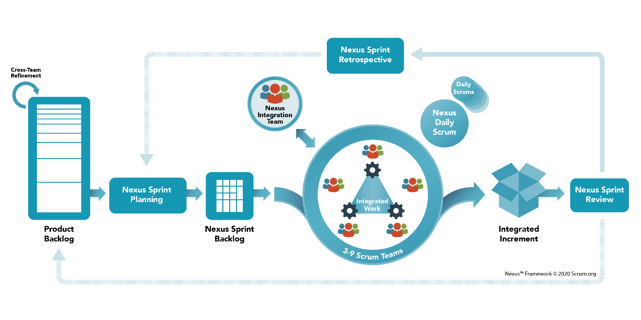
BHAG
Pillars
Learn
Execute
Roadmap
Portfolio Backlog
Portfolio Map
Scoreboard
WIGs / OKRs
Investment
AND /OR
Scrum.org’s Nexus Framework
Notes:
Well, you Keep Calm, and Scrum On. We dedicate ourselves to using Scrum to its fullest extent and even scale it if absolutely necessary.
A quick note on scaling, done improperly, scaling Scrum can introduce a good deal of arbitrary management structure. This includes roles, processes, and measurements that don’t increase the agility of the Scrum teams or the business agility of the organization. A structure like the one we’ve been building can help keep those negative effects at bay, but it’s crucial to pick a scaling framework that is also designed to preserve the elements of Scrum that support agility. I’d recommend you check out the Nexus Guide from Scrum.org if you want to dig deeper into that kind of scaling framework.
The main takeaway from this slide is the onion. Notice how the BHAG, strategic pillars, etc can be talked about in Sprint Planning and even Daily Scrums! In your day-to-day work, you could know how what you’re doing is making progress towards something important and executives can see the same!

Slide 19
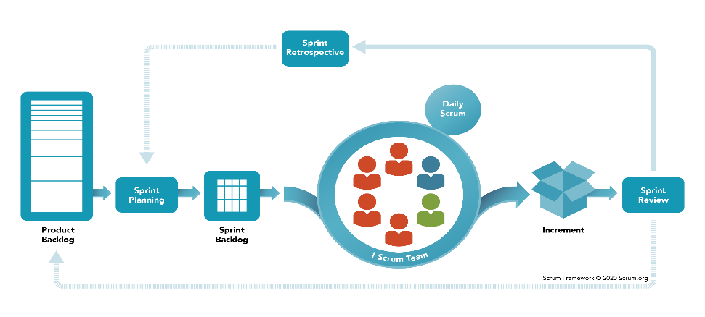

BHAG
Pillars
Learn
Execute
Roadmap
Portfolio Backlog
Portfolio Map
Scoreboard
WIGs / OKRs
Investment
AND /OR
Notes:
Last, any structure needs to be maintained and updated. Think of your home. You clean it, paint it, fix leaking roofs, and even renovate it. This structure is maintained by strong learning loops. To do that, Scrum teams and stakeholders dedicate time to creating transparency around the impact of what is being produced, inspect it to determine if what is produced is desired, and adapt what we’re doing to get more of what we want and less of what we don’t want. Think Sprint Reviews, Sprint Retrospectives, strategy sessions, and release planning. In all of these types of events, the reality of our work feeds crucial information into this whole system which can be updated to better meet the challenges of changing environments.
A word of caution, if Scrum teams and organization do not have these kinds of learning loops, it’s structure and process will move inexorably away from what is appropriate for reality and towards useless tradition. Too much of that, and we may fall off a cliff into chaos when what we spend our resources to produce won’t bring us what we need to stay in business.
I hope you can now see how carefully created structure can help us to avoid many problems and achieve incredible things. Regarding the metrics we track, It helps us choose good ones, avoid the ones that don’t really matter, and keep those good metrics from going bad. Most importantly IMHO, it helps executives trust and support Scrum teams, Scrum teams trust that their work is meaningful and effective, and organizations solve important problems that no individual could on their own.

Slide 20
Final Thoughts? Final Questions?

Slide 21

Thank you!

Slide 22
Outline
Intro
Fist to 5 alignment check
“If you aim at nothing, you will hit it every time.” – Zig Ziglar
BHAG
Strategic Pillars
WIG/OKRs
Unrealized Value
Current Value
Ability to Innovate
Time to Market
Scoreboard
Portfolio Map
Portfolio Backlog
Roadmap
Execution
Learning

Slide 23
WiG #1
OKR #1
WiG #1
OKR #1
OKR #1
WiG #2

Slide 24
Acquisition
Engagement
Mining
Monetization

Slide 26
R1
R2
R3
Q2
2nd Half
Beyond

Slide 27
BHAG
PILLARS
SCOREBOARD
PORTFOLIO BACKLOG
ROADMAP
RELEASE PLAN
SPRINT PLAN
DAILY PLAN

